Slide 1
Hardwired Delivery Presentation
Ryan Driscoll, Tom Farro, Mackenzie Miner

Slide 2

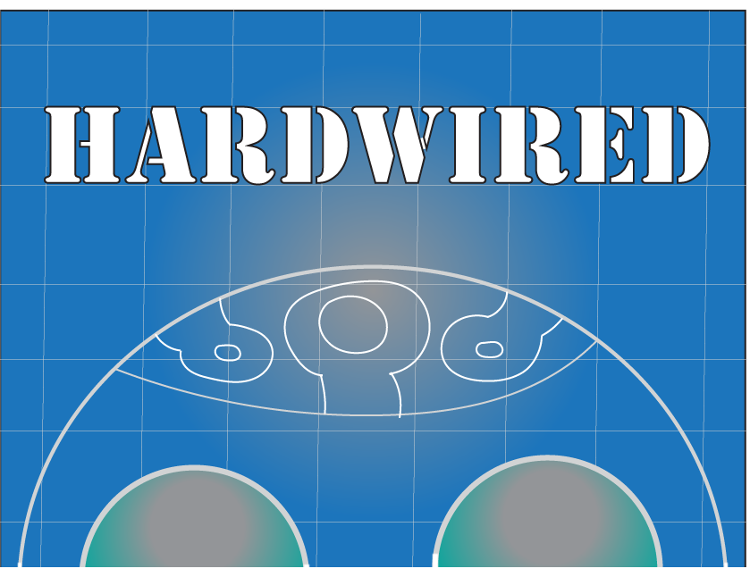
We are...
Ryan
Art
Tom
Programming
Implementation
Mackenzie
Research
Sound Effects
Writing

Slide 3
What is Hardwired?
Our goals were to create…
A personality test delivered through the Visual Novel medium
Sourced from the Meyer-Briggs personality type matrix
Major Features include…
Interpersonal decision making!
Personality assessment and profiling!
16 possible character outcomes/designs!
A secret ending for achieving all 16!

Slide 4
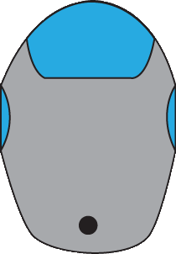
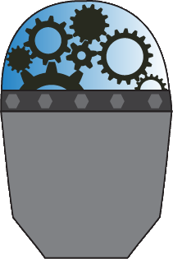


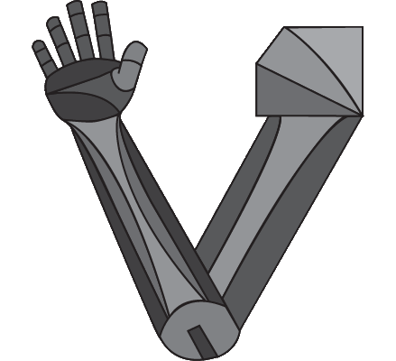
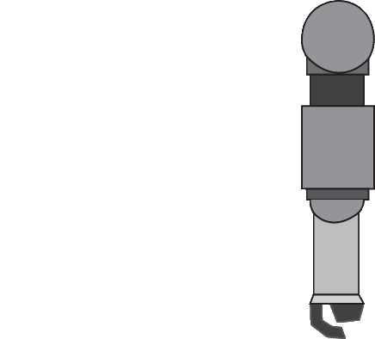
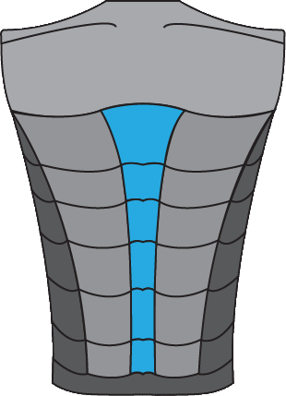
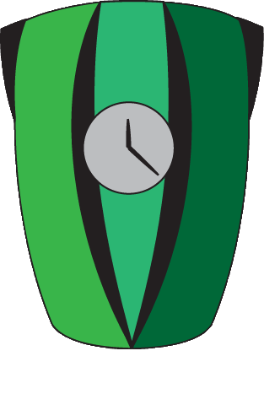
A Different Approach to Character Creation

Slide 5
Gameplay Demo!

